Slide 1


Project Screening Presentation on “Privacy Preserving Sentiment Analysis”
Students
Pawan Prabhu (1RN16CS067)
Sharan Chhibbar (1RN16CS094)
Shivank Kumar (1RN16CS100)
Guide:
Prof. Ramyashree A N
Asst. Prof. Dept. of CSE, RNSIT
Department of Computer Science and Engineering
RNS Institute of Technology
2019-20

Slide 2
CONTENTS
INTRODUCTION
Background work
Problem Statement
Existing System and Limitations
REQUIREMENTS
Functional Requirements
Non-functional Requirements
Hardware & Software Requirements
SYSTEM ARCHITECTURE/BLOCK DIAGRAM
Block diagram
Flowchart
IMPLEMENTATIONS
What is privacy?
Why privacy?
Techniques for preserving privacy
CONCLUSION
Existing system limitations
Proposed system Advantages
Current Status of Development
Market Potential
REFERENCES

Slide 3
INTRODUCTION
Background work
Problem Statement
Existing System and Limitations

Slide 4
BACKGROUND WORK
Exploring Machine learning and deep learning concepts to classify the data into positive and negative.
Prototyping of UI/UX design

Slide 5
PROBLEM STATEMENT
To perform the sentiment analysis of the reviews provided by the user .
To preserve the privacy of the user while performing the sentiment analysis.

Slide 6
EXISTING SYSTEM LIMITATIONS
The existing systems have limited methods to preserve the privacy of the users.The need arises for data publishers to protect people's privacy by anonymizing the data before publishing it.

Slide 7
REQUIREMENTS
Functional Requirements
Non-functional Requirements
Hardware & Software Requirements

Slide 8
FUNCTIONAL REQUIREMENTS
System should be able to process new reviews stored in database after retrieval
System should be able to analyze data and classify each review polarity.

Slide 9
NON-FUNCTIONAL REQUIREMENTS
User friendly
System should provide better accuracy
To perform with efficient throughput and response time.

Slide 10
HARDWARE AND SOFTWARE REQUIREMENTS
HARDWARE REQUIREMENTS
The system specifications on which the model is trained and evaluated are mentioned as follows: CPU - 8th Generation Intel Core i5 processor, RAM - 32 Gb, GPU - Nvidia GEFORCE.
SOFTWARE REQUIREMENTS
HTML & CSS to create the interface where user will submit their reviews.
Google colab to implement deep learning algorithms to classify the reviews.

Slide 11
SYSTEM ARCHITECTURE/BLOCK DIAGRAM
Block diagram
Architecture diagram
DFD/Sequence diagram/Flowchart/

Slide 12
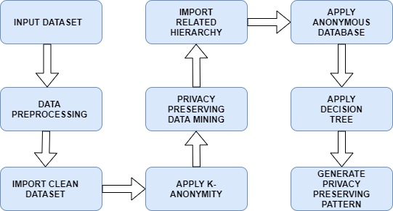
BLOCK DIAGRAM

Slide 13
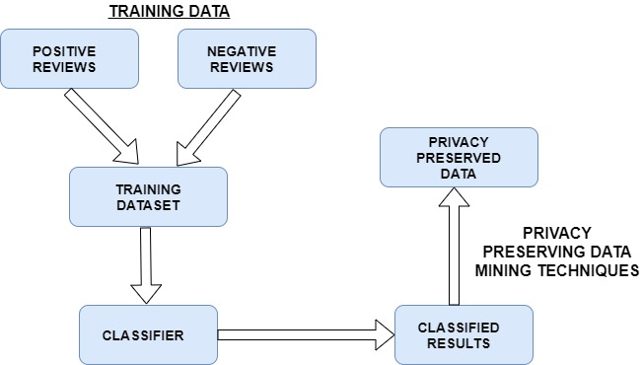
FLOWCHART

Slide 14
WHAT IS PRIVACY?
Privacy here means the logical security of data
NOT the traditional security of data e.g. access control, theft, hacking etc.
Here, adversary uses legitimate methods
Various databases are published e.g. Census data, Hospital records
Allows researchers to effectively study the correlation between various attributes

Slide 15
WHY PRIVACY?
Suppose a hospital has some person-specific patient data which it wants to publish
It wants to publish such that:
Information remains practically useful
Identity of an individual cannot be determined
Adversary might infer the secret/sensitive data from the published database.

Slide 16
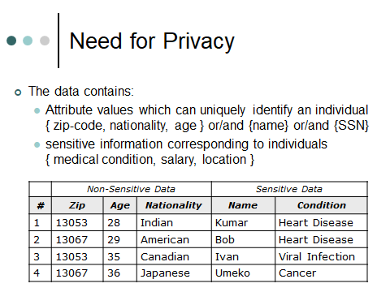
WHY PRIVACY?
Source: Privacy in Database by Aditya Paraksh

Slide 17
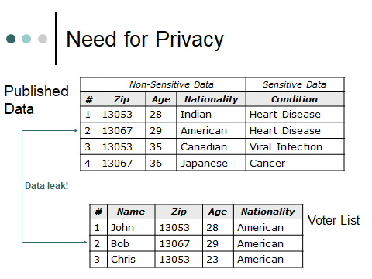
WHY PRIVACY?
Source: Privacy in Database by Aditya Paraksh

Slide 18
K-ANONYMITY
Proposed by Sweeney
Change data in such a way that for each tuple in the resulting table there are at least (k-1) other tuples with the same value for the quasi-identifier – K-anonymized table

Slide 19
TECHNIQUES FOR ANONYMIZATION
Data Swapping
Randomization
Generalization
Replace the original value by a semantically consistent but less specific value
Suppression
Data not released at all
Can be Cell-Level or (more commonly) Tuple-Level

Slide 20
CONCLUSION
Proposed System Limitations
Proposed system Advantages
Current Status of Development

Slide 21
PROPOSED SYSTEM LIMITATIONS
The proposed system limitation is the trade-off between the accuracy of the model and the amount of privacy preserved ny the model.
The balance should be made between the accuracy and privacy preservation.

Slide 22
PROPOSED SYSTEM ADVANTAGES
The main advantage of our system is the sensitive information of the user is not leaked while the sentiment analysis is performed on the data submitted by him.

Slide 23
MARKET POTENTIAL
Sentiment analysis helps you complete your market research by getting to know what your customers' opinions are about your products/services and how you can align your products/services’ quality and features with their tastes.

Slide 24
CURRENT STATUS OF DEVELOPMENT
Completed the front end part of the project.
Working on the back-end part of the project.

Slide 25
REFERENCES
C. Aggarwal, C. C. Aggarwal, and P.S. Yu, "A condensation approach to privacy preserving data mining," Advances in Database Technology-EDBT
C.C.Aggarwal and P. S. Yu, Privacy-Preserving Data Mining: Models and Algorithms, Springer Publishing Company, Incorporated, 2008.
M. Keyvanpour and S. S. Moradi, "Classification and evaluation the privacy preserving data mining techniques by using a data modificationbased framework
Synopsis

Slide 26
SUGGESTIONS….!

Slide 27
THANK YOU!!!

